Slide 1
The New Brightcove Analytics
Robert Crooks
Director of Brightcove Learning Services
Recording of the session: http://brightcove.adobeconnect.com/p1qs38imiju/

Slide 2
Agenda
What's new?
What are we losing?
What are we gaining?
Analytics API solutions
Why is it better?

Slide 3
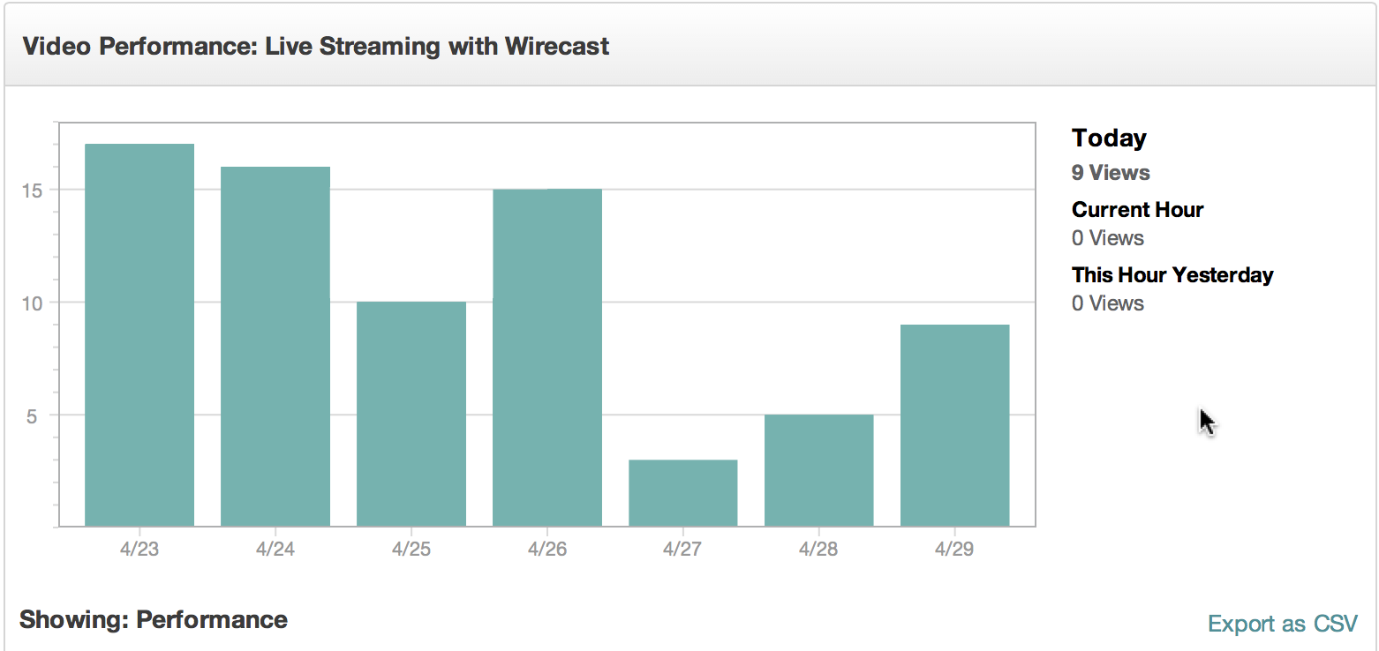
What are analytics?
Data on the performance of your video content
Uses — helps you answer questions to refine your video strategy
Which of my videos are most popular?
Which of my videos are trending?
Where is the best place on my site to place videos to maximize consumption?
How engaging are my videos? Are there places where I lose lots of viewers?
Where are my users coming from? Other domains? Search engines — what were they searching for?
What devices are my videos being watched on?

Slide 4
What's new: The new analytics UI

Slide 5
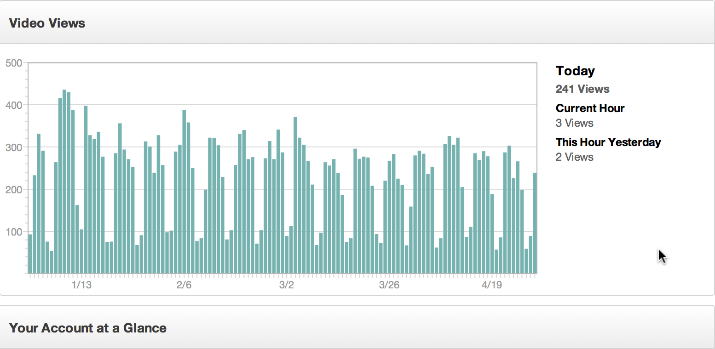
The New Analytics UI
Gives you predefined reports and charts
Customize with date ranges
Drill down into more specific data
Real-time data/updates

Slide 6
Demo

Slide 7
The new analytics API

Slide 8
The new analytics API
The backend for UI
A REST-based API that you can access from any programming language/application
Allows you to retrieve the data directly and use it in any way you like
Provides account rollups and detailed reports
Multiple dimensions and filters to allow you to retrieve just the data you want
Sample request:
https://data.brightcove.com/analytics-api/videocloud/account/20318290001?from=alltime&to=now

Slide 9
What we're losing

Slide 10
Short Term
Geo reports
Views by device/OS
Engagement reports with video player
Viewers: new/unique
Visual comparison of players/videos
All this is coming back in coming months

Slide 11
Long-Term
Browser reports

Slide 12
What we're gaining

Slide 13
Gains in the New UI
All HTML, no Flash – view on any device
Conversion rates: video views versus loads
Real-time updates (every 10 secs)
Current viewers/views
Soon: consolidated reports/analytics – no more going to two places

Slide 14
The API
This is huge!
Will allow us to integrate other parts of Studio with Analytics
Wherever you are, sort videos or players by performance or engagement
Will allow customers to build custom reports and solutions

Slide 15
Sample solutions
API Request Builder
Most Popular Videos

Slide 16
Two Basic Categories of Solutions
Custom Reports
Get a specific data-set that the built-in reports don’t provide
Represent the data differently
Do something (like create a playlist) based on analytics data
Most popular videos
Trending videos
Choose most popular among a set of relevant videos

Slide 17
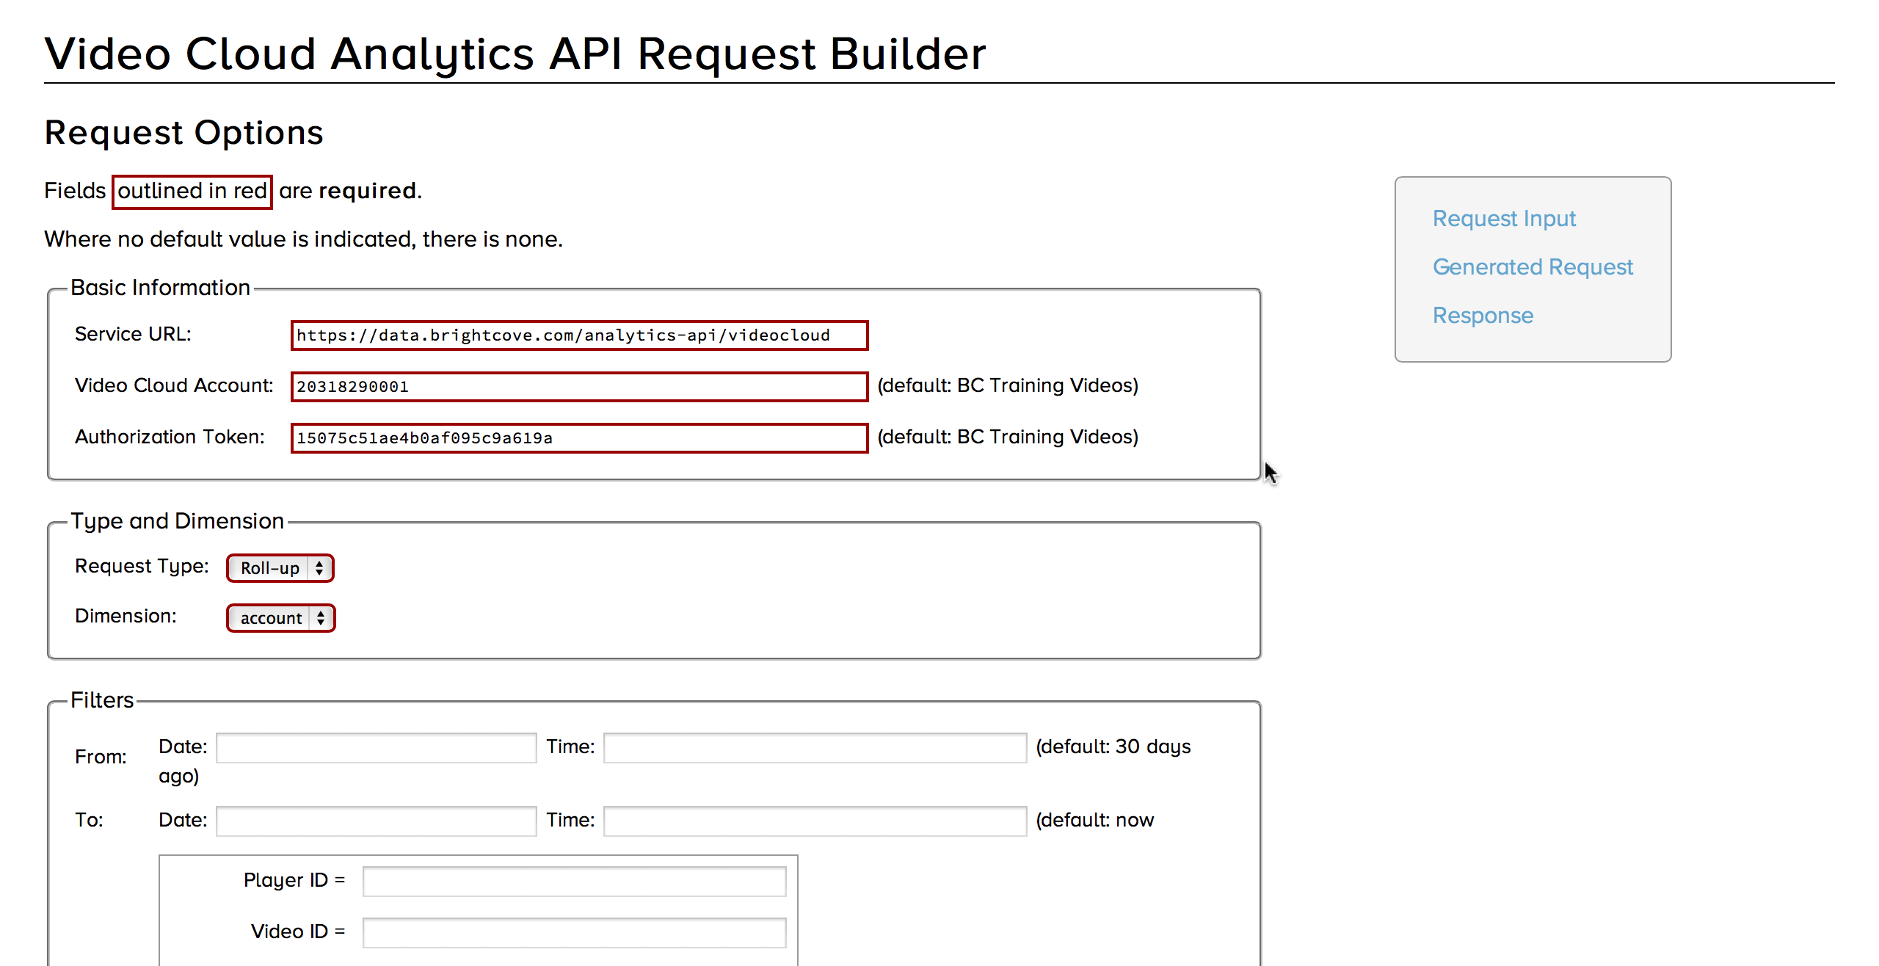
Request builder
Use a form to get the request type, dimensions, filters
A lot of conditional logic to build the request
Here submitted to a PHP page — output in an iframe

Slide 18
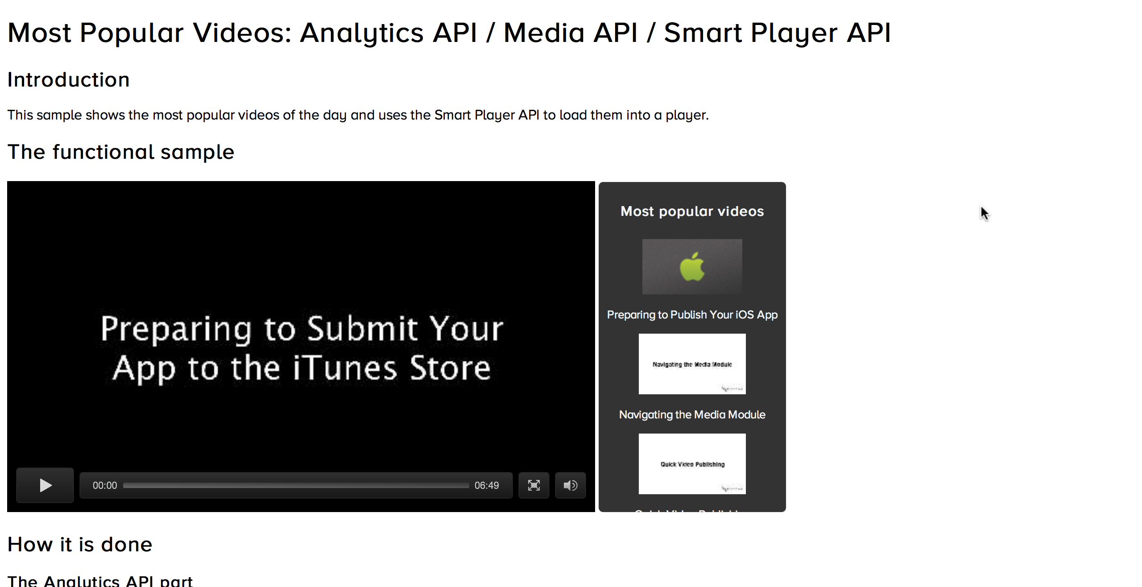
Most popular videos
Get a report on dimension video over the past 24 hours (or choose your timeframe)
Sort by video_view
Limit the results to the number of videos you want to display
Use the Media API to retrieve those videos
Use the Smart Player API to load them into a player

Slide 19
Why It's Better
New UI
All in HTML, viewable on iPads
Real-time updates
Conversion rates
Engagement scores for quick comparisons
New API
Future integration between modules
Custom reports
Real-time analytics-driven video solutions

